Slide 1
String object . String methods
By Volodymyr Lukashevych

Slide 2
AGENDA
Quotes
Special Characters
String length
Accessing characters
Searching for a substring
Getting a substring
String comparison

Slide 3
Strings
In JavaScript, the textual data is stored as strings. There is no separate type for a single character.
The internal format for strings is always UTF-16, it is not tied to the page encoding.

Slide 4
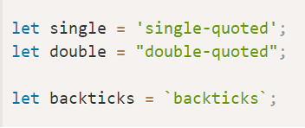
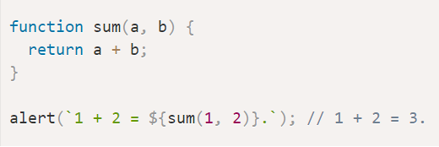
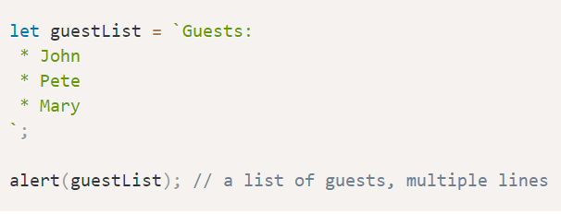
Quotes
Strings can be enclosed within either single quotes, double quotes or backticks:
Single and double quotes are essentially the same. Backticks, however, allow us to embed any expression into the string, by wrapping it in ${…} :

Slide 5
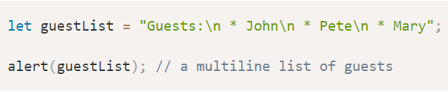
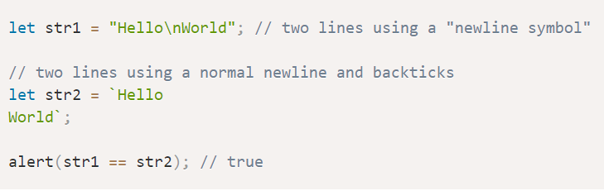
Special characters
It is still possible to create multiline strings with single and double quotes by using a so-called “newline character”, written as \n, which denotes a line break:

Slide 6
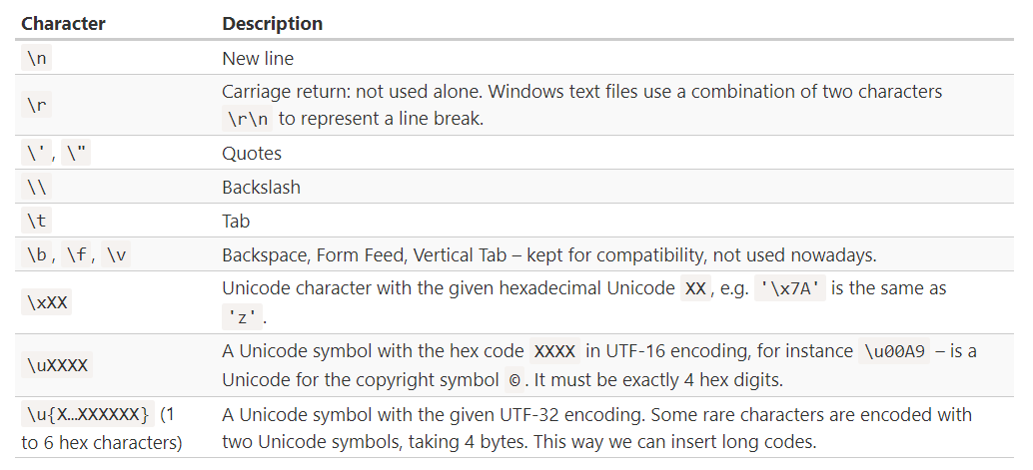

Slide 7


All special characters start with a backslash character \ It is also called an “escape character”.
Note that the backslash \ serves for the correct reading of the string by JavaScript, then disappears. The in-memory string has no \
What If we need to show an actual backslash within the string?
That’s possible, but we need to double it like \\

Slide 8

String length
The length property has the string length.
Note that \n is a single “special” character, so the length is indeed 3.

Slide 9
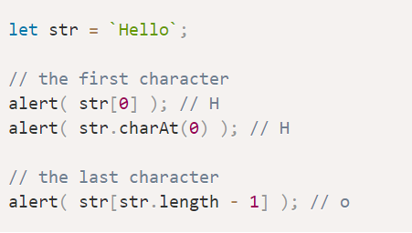
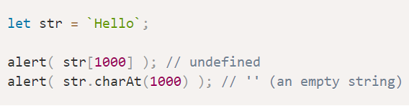
Accessing characters
To get a character at position pos , use square brackets [pos] or call the method str.charAt(pos). The first character starts from the zero position:
The square brackets are a modern way of getting a character, while charAt exists mostly for historical reasons.
The only difference between them is that if no character is found, [] returns undefined, and charAt returns an empty string.

Slide 10
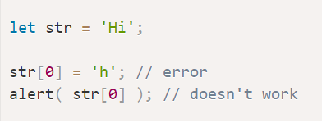
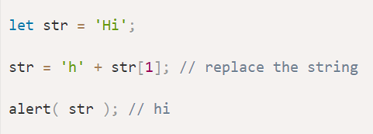
Strings are immutable
Strings can’t be changed in JavaScript. It is impossible to change a character.
The usual workaround is to create a whole new string and assign it to str instead of the old one. For instance:

Slide 11


Changing the case
Methods toLowerCase() and toUpperCase() change the case:
Or, if we want a single character lowercased:

Slide 12
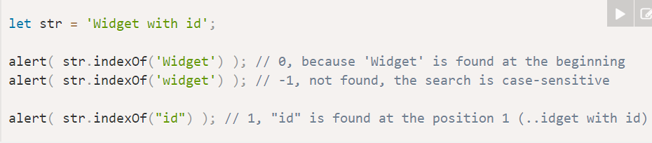
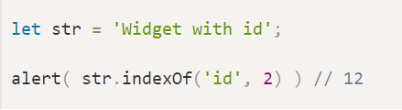
Searching for a substring
The first method is str.indexOf(substr, pos). It looks for the substr in str, starting from the given position pos, and returns the position where the match was found or -1 if nothing can be found.
The optional second parameter allows us to start searching from a given position. For instance, the first occurrence of “id” is at position 1. To look for the next occurrence, let’s start the search from position 2:

Slide 13
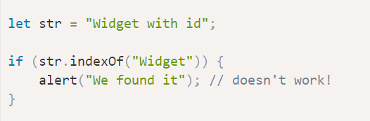
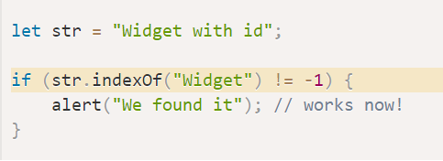
There is also a similar method str.lastIndexOf(substr, position) that searches from the end of a string to its beginning. It would list the occurrences in the reverse order.
There is a slight inconvenience with indexOf in the If test. We can’t put it in the If like this:

Slide 14
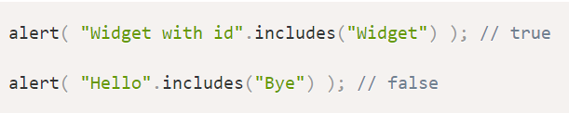


includes, startsWith, endsWith
The more modern method str.includes(substr, pos) returns true/false depending on whether str contains substr within.
It’s the right choice if we need to test for the match, but don’t need its position:
The optional second argument of str.includes is the position to start searching from:
The methods str.startsWith and str.endsWith do exactly what they say:

Slide 15
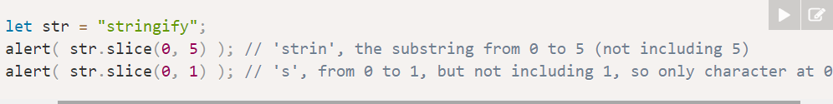

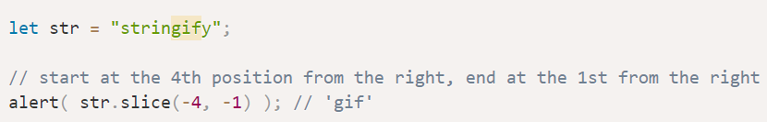
Getting a substring
There are 3 methods in JavaScript to get a substring: substring, substr, slice.
Str.slice(start [, end])
Returns the part of the string from start to (but not including) end.
If there is no second argument, then slice goes till the end of the string:
Negative values for start/end are also possible. They mean the position is counted from the string end:

Slide 16
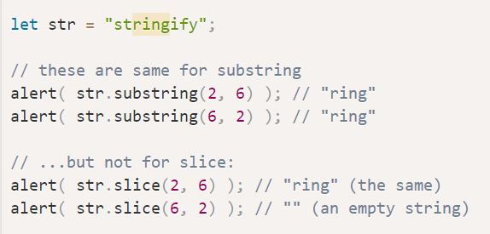
Str.substring(start [, end])
Returns the part of the string between start and end.
This is almost the same as slice, but it allows start to be greater then end.
Negative arguments are (unlike slice) not supported, they are treated as 0

Slide 17


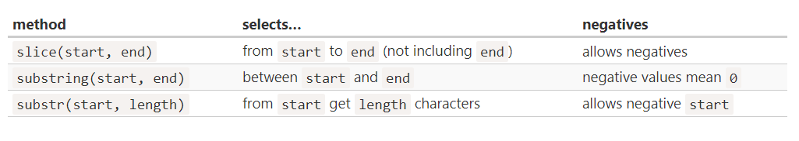
Str.subst(start [, length])
Returns the part of the string from start, with the given length.
In contrast with the previous methods, this one allows us to specify the length instead of the ending position:
The first argument may be negative, to count from the end:

Slide 18
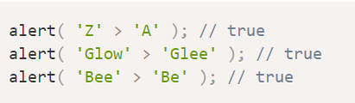
String comparison
To see whether a string is greater than another, JavaScript uses the so-called “dictionary” or “lexicographical” order In other words, strings are compared letter-by-letter.
The algorithm to compare two strings is simple:
Compare the first character of both strings.
If the first character from the first string is greater (or less) than the other string’s, then the first string is greater (or less) than the second. We’re done.
Otherwise, if both strings’ first characters are the same, compare the second characters the same way.
Repeat until the end of either string.
If both strings end at the same length, then they are equal. Otherwise, the longer string is greater.

Slide 19
There are several other helpful methods in strings:
str.trim() – removes (“trims”) spaces from the beginning and end of the string.
str.repeat(n) – repeats the string n times.
…and more to be found in the https://developer.mozilla.org/en-US/docs/Web/JavaScript/Reference/Global_Objects/String.
Strings also have methods for doing search/replace with regular expressions. But that’s big topic.

Slide 20


